Slide 1
Lecture 1
Notes:
从这节课开始，我们就进入了ap stas正式学习了。
回想一下第一节课我们提到过的，统计学的内容。

Slide 2
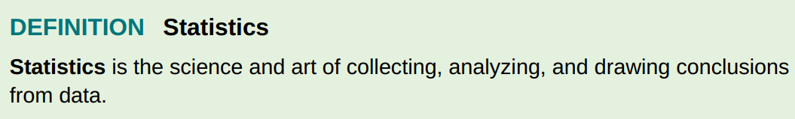
Find a problem
Understand the nature of the problem
How to measure it
Data collection
Data summarization
Formal Analysis
Interpretation of results
Notes:
The second step “..” is actually to define the variables in this problem we want to research.
所以variable可以说是我们整个学科的基础。

Slide 3
Lecture 1
Variable
Notes:
所以我们这节课就学习变量 variable

Slide 4
Activity
Talk about your holiday about :
1. travel or not ( yes or no )
2. # of days used for travelling
3. female or male
Notes:
那我们接下来做一个小活动，大家来想一下这三个问题，我一会找几位同学，把答案总结写在白板上

Slide 5
Name | Travel or not | # of traveling days | gender
Individuals are objects described by a set of data.
A variable is a characteristic that changes from one individual to another.
A categorical/qualitative variable take on category names or group labels
A quantitative/numerical variable takes on numerical values
Notes:
我们先看一下individuals的定义，大家再看一下，在这组数据中，哪些是individuals
Def，也就是说，这组数据是谁产生的，属于谁
这几位同学就是individuals
每个individual都有一个或一组数据
如果我得到的数据是这样的 （只有name 和 travel or not），我这组数据就叫univariate data
Variable 对于不同individual是有不同的取值的
大家说哪个是 categorical，哪个是quantitative？

Slide 6
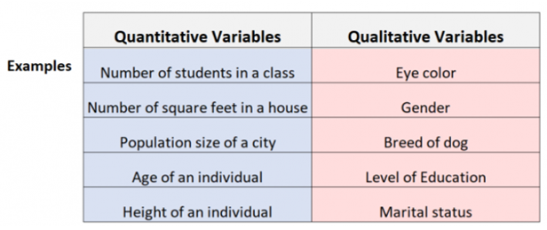
Notes:
帮助理解再给大家几个例子，给时间记一下。
ˈmærɪtl
ˈsteɪtəs

Slide 7
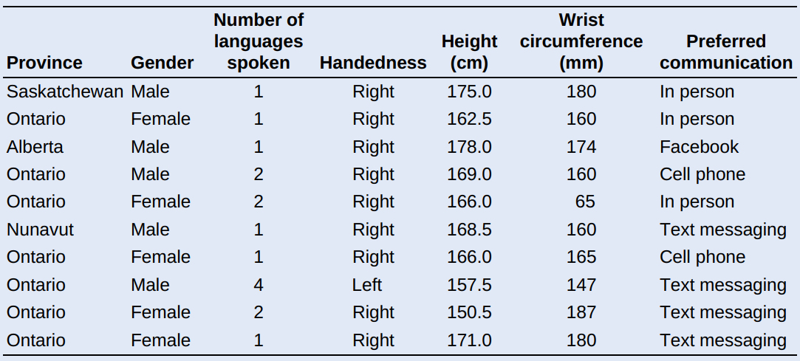
PROBLEM: Census At School is an international project that collects data about primary and secondary school students using surveys. Hundreds of thousands of students from Australia, Canada, Ireland, Japan, New Zealand, South Africa, South Korea, the United Kingdom, and the United States have taken part in the project. Data from the surveys are available online. We used the site’s “Random Data Selector” to choose 10 Canadian students who completed the survey in a recent year. The table displays the data.
Variables
10 individuals
Notes:
识别一下individual是什么，variable是什么并分类。
大家发现很难界定cate和nume，这个很正常，是要看现实中研究的问题想要把它理解为哪种变量。比如这个语言的数量，想研究一个地区的语言水平 / 统计#=1的人是什么特质，这是就是一个分类。
不同语言数量的人会不会prefer 不同的交流方式？
平均说几门语言？

Slide 8
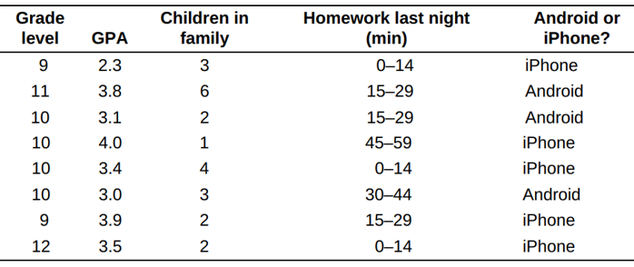
Not every variable that takes number values is quantitative. zip code, phone number, ID card number ……
Notes:
有个办法就是求均值，看看是否有意义。考试中不会出模棱两可的题的。

Slide 9
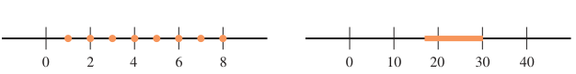
Definition
discrete variable
Quantitative variable
continuous variable
Discrete variable:
the possible values of the variable correspond to isolated points on the number line.
Continuous variable:
the possible values form an entire interval on the number line.
Notes:
让学生举例
Dis：早上吃了几碗饭，年龄
Con：身高体重

Slide 10
Variable
Quantitative variable
Discrete
Continuous
Categorical variable
Summary
Notes:
下节课学习怎么描述cate的变量。

Slide 11
Lecture 2
Displaying Categorical Data
with Tables and Graphs

Slide 12
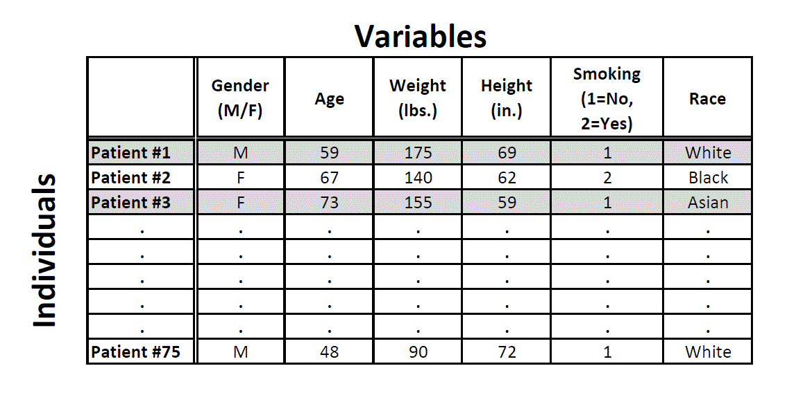
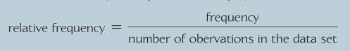
How to measure categorical variables?
categorical
categorical
A frequency table shows the number of individuals having each value.
categorical
frequency distribution table
Frequency (counts)
Relative Frequency (percentage/proportion)
A relative frequency table shows the proportion or percent of individuals having each value.
Relative frequency distribution table
Notes:
我们要面临的第一个问题就是
How to measure it? Numerical是可以直接用本身的数字衡量的，categorical不一样
先看一下哪些是categorical呢？
描述这些categorical vars 的方法是 Frequency 计数 或者 relative Frequency 计算比例
Frequency很好理解，比如有一位male 两位female
比例的公式就是 33.3%的male，66.6%的female
那display the categorical data的方式又有两个，一个是用table表格，还有一个使用graph图象。
我们先来看表格，比如
Gender #
F 2
M 1
这样的就叫 Frequency table
把 # 换成 比例就是relative fre table
又叫 ….

Slide 13
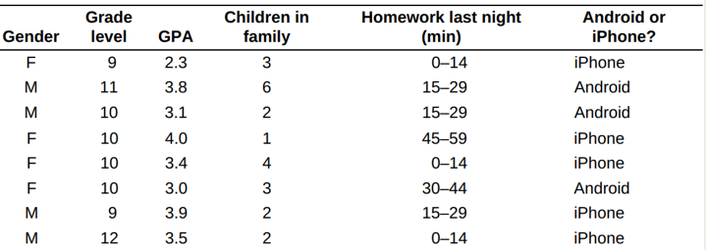
Here is a small part of the data set that describes the students in a class. The data come from anonymous responses to a questionnaire filled out on the first day of class.
Notes:
看一下小测试的题
əˈnɒnɪməs
Classify the varibales

Slide 14
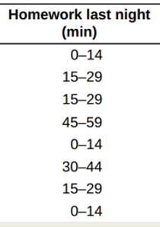
Note that the frequencies and relative frequencies listed in these tables are not data !!!!!!!
HW last night | Frequency
0-14 | 3
15-29 | 3
30-44 | 1
45-59 | 1
Notes:
以HW last night为例，大家尝试生成一下它的 Frequency table
Note：
Q:小测第四题的individuals 是啥？

Slide 15
Note that the frequencies and relative frequencies listed in these tables are not data !!!!!!!
Relative Frequency Proportion | Relative Frequency Percent
0.375 | 37.5%
0.375 | 37.5%
0.125 | 12.5%
0.125 | 12.5%
HW last night | Frequency
0-14 | 3
15-29 | 3
30-44 | 1
45-59 | 1

Slide 16
Frequency tables sometimes are difficult to read.
Sometimes it is easier to analyze a distribution by displaying it with a bar graph or pie chart.
Notes:
Bar chart 和histogram不一样
柱状图和直方图

Slide 17
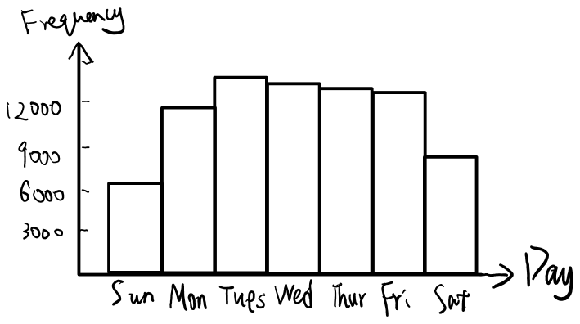
Bar Graph
1. Draw a horizontal axis, and write the category names or labels below the line at regularly spaced intervals.
2. Draw a vertical axis, and label
the scale using either frequency
or relative frequency.
3. Place a rectangular bar above
each category label. The heights
of bars that represent the
frequency or relative frequency,
so all bars should have the same
width. With the same width, both
the height and the area of the bar are proportional to frequency and relative
frequency
Notes:
横纵坐标要标好，bars之间要隔开

Slide 18
Bar Graph
bars equally wide.
Spaced intervals
Name of the horizontal and vertical axis
Notes:
横纵坐标要标好，bars之间要隔开

Slide 19
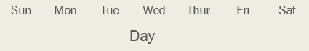

Bar charts - beware of vertical axis...
Notes:
Start from 0!!

Slide 20
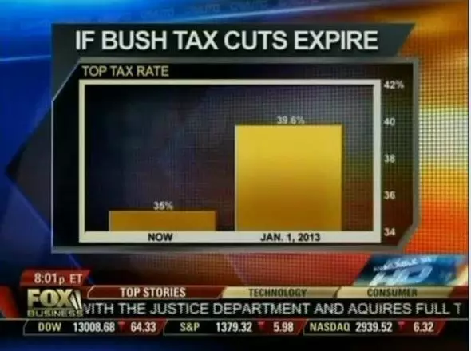
39.6% never looked so much larger than 35% !!!
Notes:
政治上有时会通过“错误”来误导民众

Slide 21
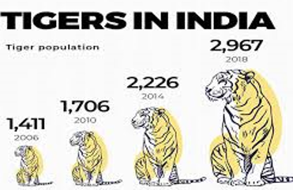
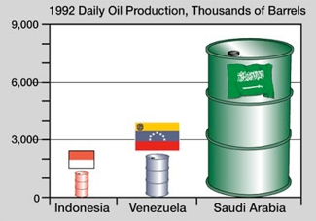
- pictograms are in 2-dimension
- making the increase/decrease seem much more dramatic.
Avoid pictograms!
Notes:
Because doctor pictogram is 2D, halving it, i.e. halving both dimensions (height and width), means reducing the area by a factor of 4, making the decrease seem much more dramatic.
Avoid pictograms!

Slide 22
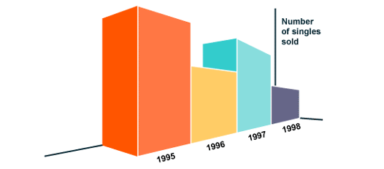
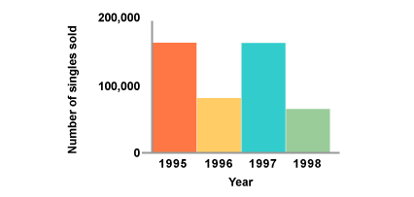
Avoid perspective (3D) bar charts - they are misleading

Slide 23

Video Time！
Notes:
在这个视频中出现了很多推论和预测，像10分钟的Google搜索量就能供电拉斯维加斯半小时，
这些结论都不是一拍脑门就能想出来的，都是需要理论和一定的数据量作为evidence来支持的。
无论是处理数据，还是分析问题的方法，这里面都有很深的学问，也是统计学中的一部分。
就像我们昨天见过的一样。

Slide 24
By the end of this section, you should be able to:
Make and interpret frequency table, relative frequency table and two-way table
Calculate marginal and joint relative frequencies from a two-way table
Calculate conditional relative frequencies from a two-way table

Slide 25
Data Analysis: Making Sense of Data
DISPLAY categorical data with a bar graph
IDENTIFY what makes soe graphs of categorical data deceptive
CALCULATE and DISPLAY the marginal distribution of a categorical variable from a two-way table
CALCULATE and DISPLAY the conditional distribution of a categorical variable for a particular value of the other categorical variable in a two-way table
DESCRIBE the association between two categorical variables

Slide 26
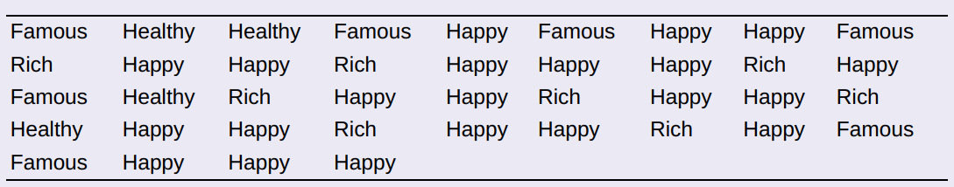
Check your understanding
The American Statistical Association sponsors a web-based project that collects data about primary and secondary school students using surveys. We used the site’s “Random Sampler” to choose 40 U.S. high school students who completed the survey in a recent year. One of the questions asked: Which would you prefer to be? Select one. ________Rich ________Happy ________Famous ________Healthy Here are the responses from the 40 randomly selected students:
Make a relative frequency bar graph of the data.

